Slide 1
Hands-On Training
Advanced Apex
Unit Testing Techniques

Slide 2

John M. Daniel
Salesforce Architect

Slide 3






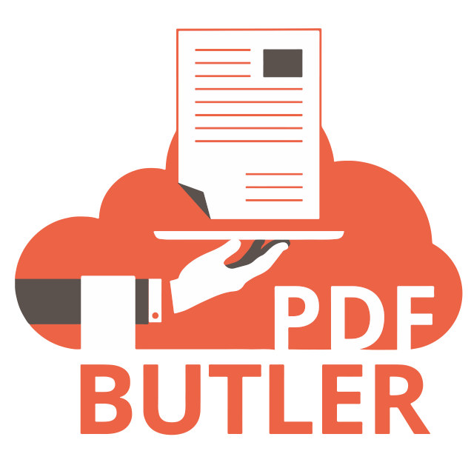







Slide 4
Agenda

Slide 5
Agenda
Get folks setup
Common issues when setting up unit tests
What is mocking?
What is dependency injection?
Constructor based Injection vs Factory based injection
Notes:
Session Abstract:
When you have complex applications with custom logic, ensuring that the codebase has sufficient test coverage can be tricky. Come learn some of the advanced techniques that will help you organize your test code coverage and make it far easier to maintain. The learning objectives include: learn to identify ways to refactor your code to be provide opportunities for modularize your code learn how the technique of "mocking" certain elements can save you time and headaches and help you bring clarity to your unit test. learn how centralizing common elements into test data factories can improve reuse of code learn on various open source mocking frameworks available in the community.

Slide 6
Get Setup!
Notes:
https://tinyurl.com/SED23HOTFEP

Slide 7
Get Setup!
Sample Code repo from GitHub
https://tinyurl.com/SED23HOTAAUTT

Slide 8
Common Issues
Notes:
https://tinyurl.com/SED23HOTFEP

Slide 9
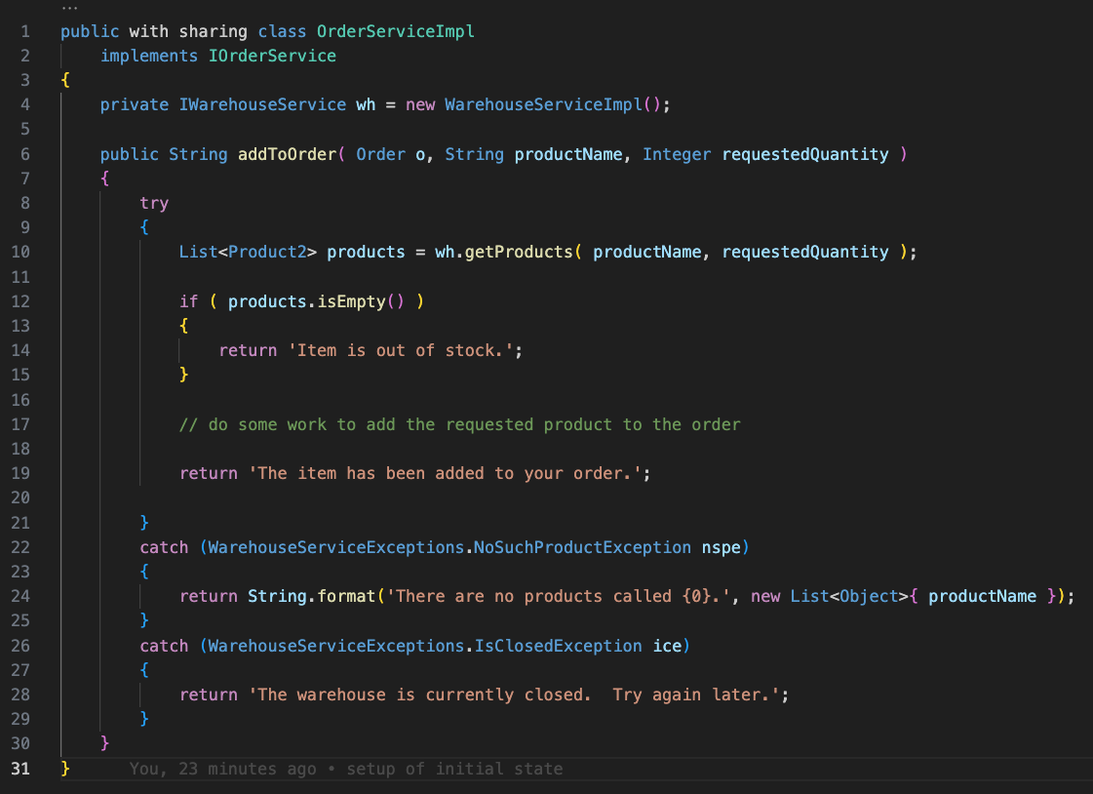
Common Issues For Unit Testing
OrderServiceImpl
Manages Order processing
addToOrder method
Access to WarehouseServiceImpl
Reports to caller …
When out of stock
No products by that name
Warehouse is closed
Item added to order

Slide 10
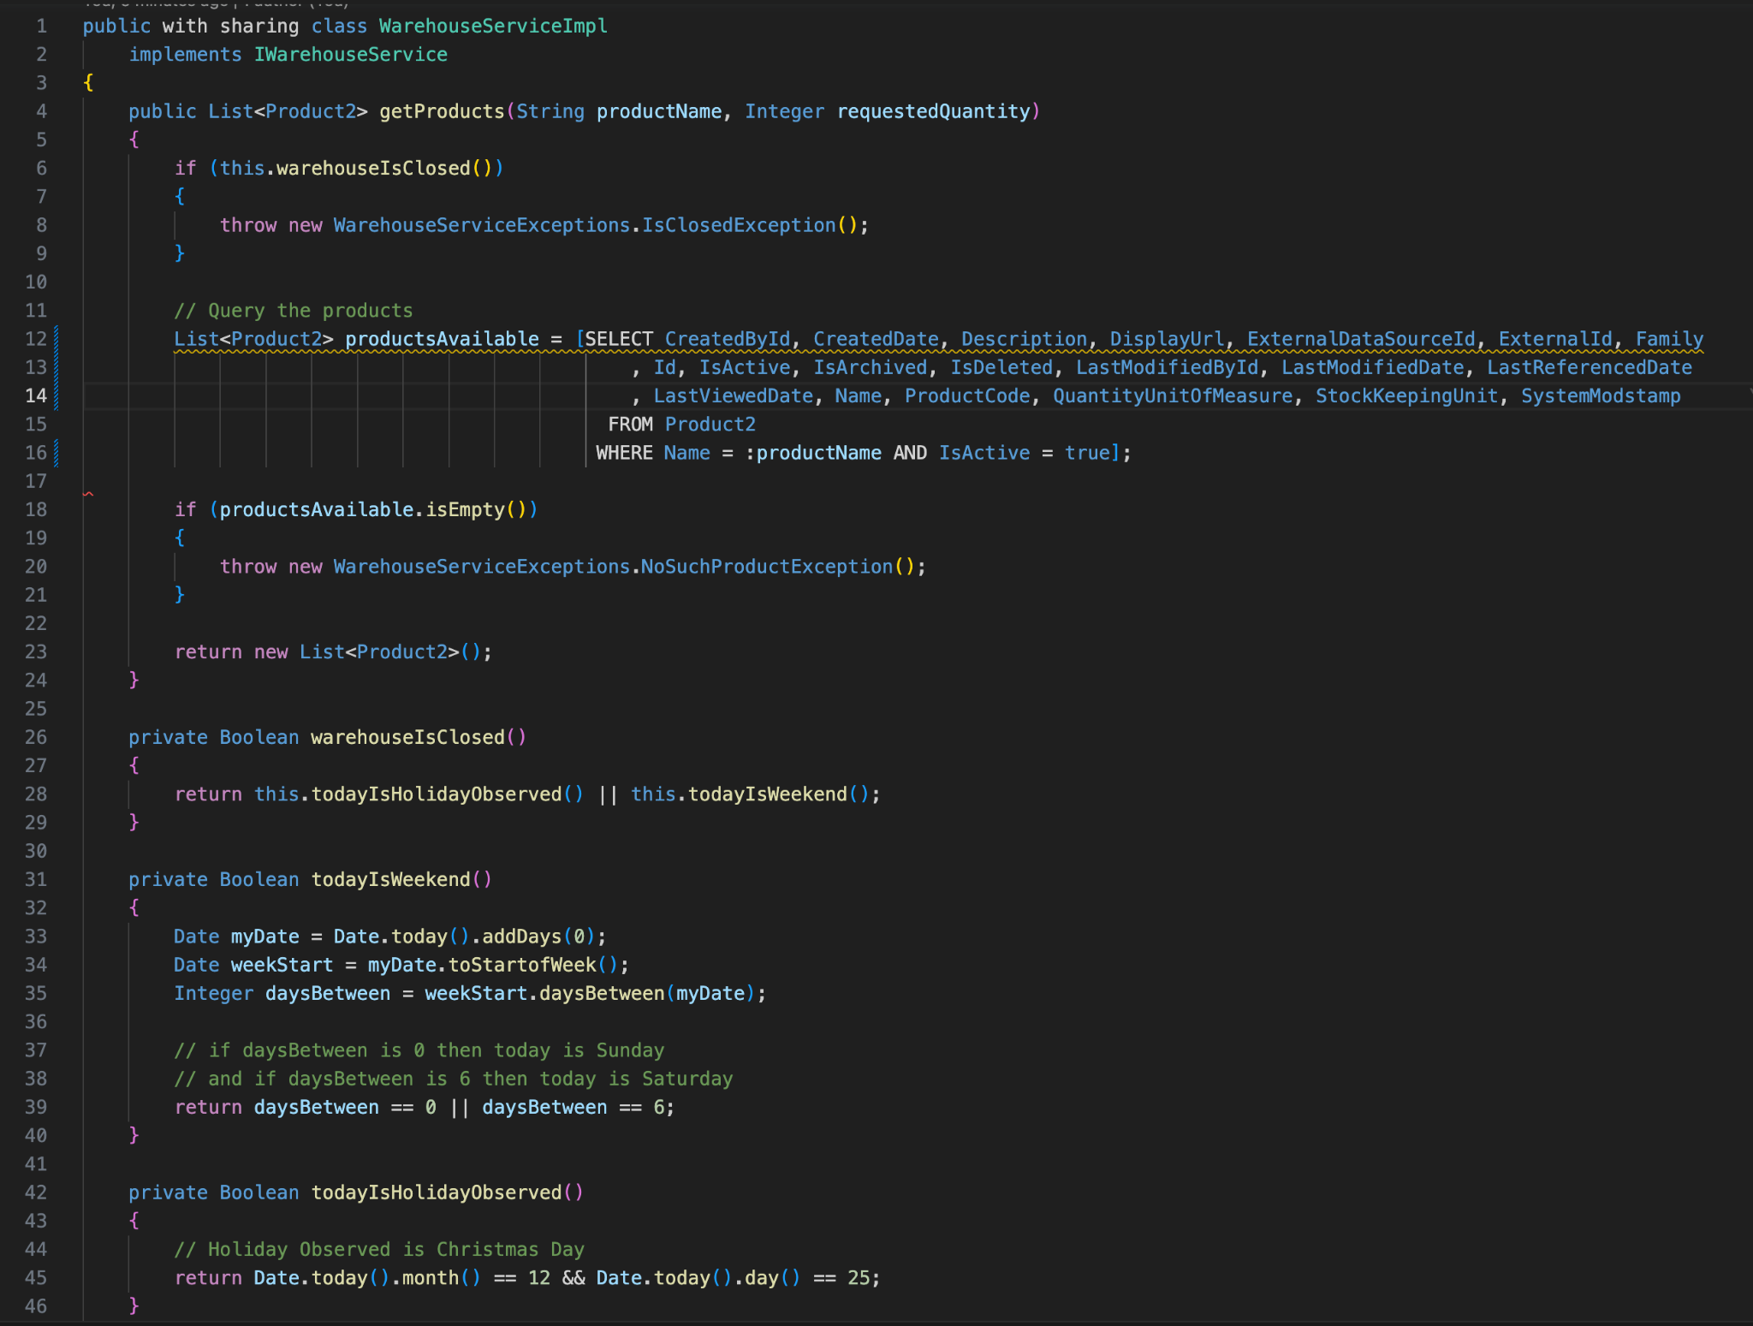
Common Issues For Unit Testing
WarehouseServiceImpl
Manages Warehouse processing
getProducts() method
In-line Product2 query
warehouseIsClosed() method
Warehouse is closed on the weekend and on Christmas day.

Slide 11
Common Issues For Unit Testing
How do we test OrderServiceImpl??
Issues:
The data setup to make WarehouseService work correctly is extensive
Reference comments in the OrderServiceTest.testSetup() method
What would be needed to make the WarehouseService throw a WarehouseServiceExceptions.NoSuchProductException ?
What would be needed to make the WarehouseService throw a WarehouseServiceExceptions.IsClosedException ?

Slide 12
What is “mocking”?
Notes:
https://tinyurl.com/SED23HOTFEP

Slide 13
Mocking in Unit Tests
“In object-oriented programming, mock objects are simulated objects that mimic the behavior of real objects in controlled ways, most often as part of a software testing initiative. A programmer typically creates a mock object to test the behavior of some other object, in much the same way that a car designer uses a crash test dummy to simulate the dynamic behaviour of a human in vehicle impacts.”
– “Mock Object”, Wikipedia

Slide 14
Mocking in Unit Tests
General idea behind mock objects is that it gives you the ability to tell classes what to expect from other classes.
Makes your unit tests completely encapsulated from its dependencies.
“Mocking” is the idea of replacing these heavier, complex logic elements with mocked, “faked” versions that can be configured to behave in certain ways.
Mocked dependencies
Are faster, lighter, and consistent in the implementation
Do exactly what is required to test the Apex class in question. Nothing more, nothing less.
Mocking dependencies isolates the specific piece of logic being tested – this is a true unit test!!!
Mocking relies on the concept of Dependency Injection

Slide 15
What is “dependency Injection”?
Notes:
https://tinyurl.com/SED23HOTFEP

Slide 16
Dependency Injection
It is the ability to pass dependencies into a class rather than the class instantiating them
Three main types of Dependency Injection
Constructor-based
Setter-based
Factory-based

Slide 17
Constructor Based Injection vs Factory Based injection
Notes:
https://tinyurl.com/SED23HOTFEP

Slide 18
Constructor vs Factory Based Injection
Constructor Based Injection
Pass an instance of the dependency as a parameter on the “constructor” method for the class
Forces that a dependency be supplied to get the class
Dependency can be swapped out for a mock instance in a unit test.
Notes:
Focus on changes needed to add the WarehouseService class

Slide 19
Constructor vs Factory Based Injection
Factory Based Injection
Your class makes a call to a central “factory class” asking for an instance of the dependency that it needs.
The factory decides what should be returned for the dependency.
Factory can be set to return a mock instance during unit test.
Doesn’t require a parameter for your class constructor.
This is helpful for times when you want to use “Type.newInstance()”
Notes:
Focus on changes needed to add the WarehouseService class

Slide 20
Mocking…
Let’s write some code
Notes:
Markers
SELECTOR-01
SELECTOR-02

Slide 21
But wait!
There’s more!

Slide 22
Want to learn more???
Blogs
See main README file on FFLib ApexMocks Framework Repo

Slide 23
Want to learn more???
Frameworks and Sample Code Repos
FFLIB Apex Mocks https://github.com/apex-enterprise-patterns/fflib-apex-mocks
FFLIB Apex Common https://github.com/apex-enterprise-patterns/fflib-apex-common
specifically fflib_ApplicationTest.cls
FFLIB Apex Common Samplecode https://github.com/apex-enterprise-patterns/fflib-apex-common-samplecode
Specifically AccountsServiceTest, OpportunitiesServiceTest, OpportunitiesTest and OpportunityApplyDiscountControllerTest

